Slide 1


Optimizing Customer Service Delivery for Lenovo Data Center Group
Carlos Gonzalez; Madhura Indurkar; Akshay Joshi; Archit Ramprasad
North Carolina State University
Team Presentation
December 1, 2017

Slide 2
Introduction

Slide 3
Lenovo DCG is focused on providing enterprises with server, storage and networking solutions
Lenovo provides High Volume solutions to the entire NA and 6 major countries in LA
In last financial year*, the customer service department handled ~11K claims with only 233 escalations
10
206
6
9
2
* Financial year runs from August 2016 to July 2017
Escalations
FOP
CRU
ONS
NPRA

Slide 4
Lenovo wants to implement a data driven approach to optimize customer service delivery
Gap
Lenovo DCG doesn’t know how to assign service actions to its customers
Current State
Future State
DCG group provides High volume server and networking solutions.
They would like to optimize customer service delivery to reduce costs and improve efficiency.
DCG now uses data driven decision making in order to provide expedient service to their customers.
They also use the learnings to improve the customer service delivery.
Key Questions
How to assign optimal service action for incoming service claims?
How to assign next service action to hold down service costs?

Slide 5
Methodology

Slide 6
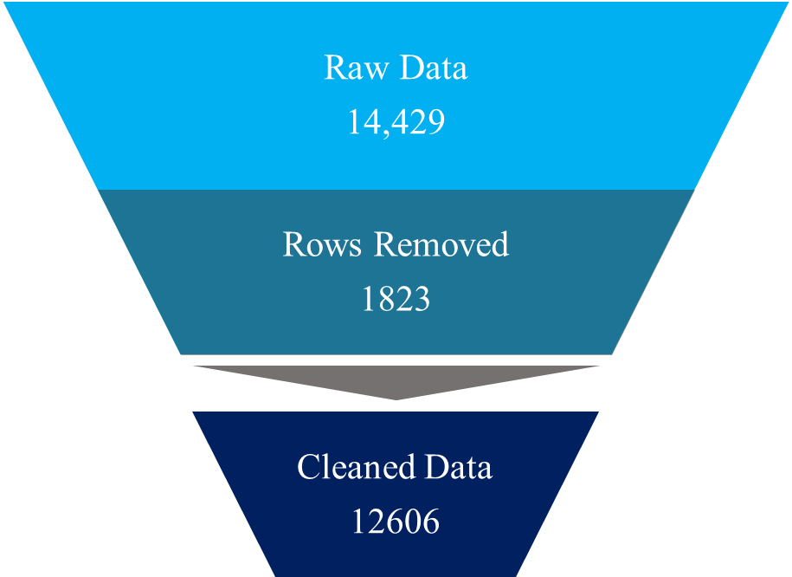



Predictive modelling and Policy Iteration methodology was implemented post data prep
Raw Information
Data Cleaning
North America
Data Prep
Latin America
Input Data
Derived Columns
Machine Status
Cost Structure

Slide 7
Analysis
&
Recommendations

Slide 8

Data Preparation and EDA helped standardize the raw information and draw preliminary insights
Exploratory Data Analysis
North America
10,554
Latin America
3875
Identify underlying trends in the data
Answer questions to better understand the data
Gain insights for downstream applications
Raw Data
14,429
Rows Removed
1823
9271 rows
This dataset was used to train and test the logistic regression model
12602 rows
This dataset was used to build the Natural history model and Policy iterations
Click here for details
Cleaned Data
12606
Data Preparation
Create derived columns based on assumptions
Compute cost structures
Machine Level Data
Problem Level Data

Slide 9


Logistic Regression model was used to select the best service type for an incoming service request
Confusion Matrix
 |  | Predicted
 |  | 0 | 1
Actual | 0 | 56 | 4
 | 1 | 23 | 2520
Machine Level Data
Training Dataset
Logistic Regression Model
9271 rows
This dataset was used to train and test the logistic regression model
Implemented in R
Function: GLM; Family Binomial and link: Logit
Model was used to predict values in the testing dataset to compute model efficiency parameters
Model Parameters
Accuracy | 98%
Balanced Accuracy | 96%
Sensitivity | 97%
Specificity | 93%
Positive Prediction | 99%
Negative Prediction | 70%
Testing Dataset

Slide 10
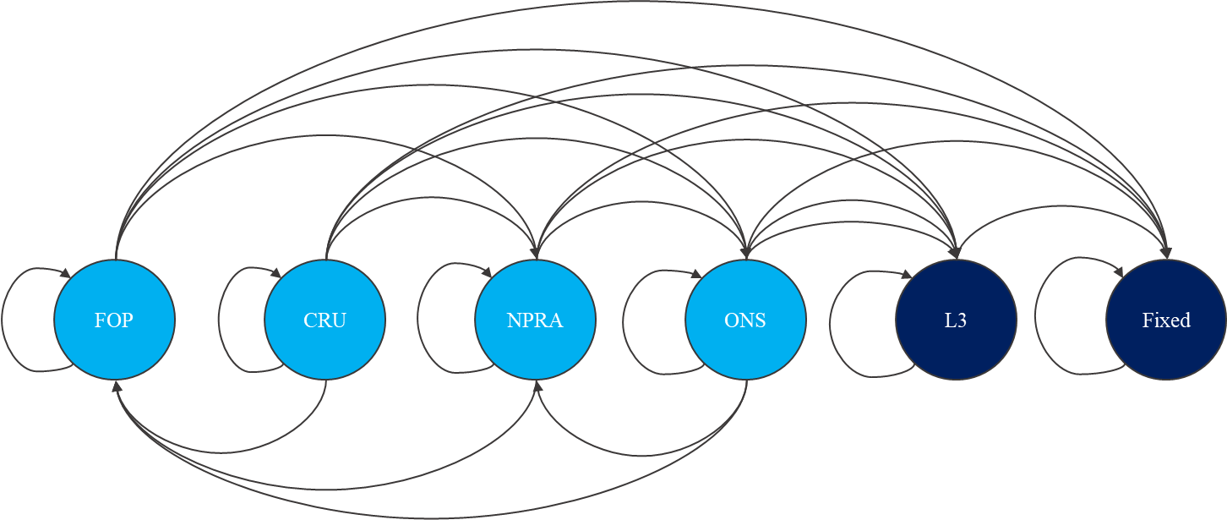
Natural history model was used to compute time estimates to better understand the service process
Observations
Most of the time, an initial service action fixed the problem
CRU was responsible for highest loss of time before getting fixed or escalated to L3
Both ONS and FOP had a high rate of getting fixed
 | FOP | CRU | NPRA | ONS | L3 | Fixed
FOP | 0.077 | 0 | 0.022 | 0.025 | 0.007 | 0.865
CRU | 0.018 | 0.054 | 0.015 | 0.025 | 0.006 | 0.882
NPRA | 0.012 | 0.002 | 0.083 | 0.155 | 0.023 | 0.725
ONS | 0.009 | 0 | 0.103 | 0.156 | 0.022 | 0.708
L3 | 0 | 0 | 0 | 0 | 1 | 0
Fixed | 0 | 0 | 0 | 0 | 0 | 1
Top five Paths to Fix
Broken-ONS-Fix | 5193
Broken-FOP-Fix | 1396
Broken-CRU-Fix | 1094
Broken-ONS-ONS-Fix | 1022
Broken-ONS-ONS-ONS-Fix | 307

Slide 11
Natural history model was used to compute time estimates to better understand the service process
Observations
ONS and FOP both provide very similar and positive results
CRU and NPRA provide worse results
Starting service action | Probability of L3 | Probability of Fixing
FOP | 0,008 | 0,992
ONS | 0,009 | 0,991
CRU | 0,026 | 0,974
NPRA | 0,027 | 0,973
Transitions until first absorption given starting states
CRU | 1,328
NPRA | 1,303
ONS | 1,151
FOP | 1,141

Slide 12
Policy Iteration methodology was implemented to find the optimal rules for service actions
MDP Model:
Machine Age Segments:
Early: (1-20) Months, Mid: (21-40) Months, Late: (41 – 60) Months
State Space: (Early, Mid, Late, Fixed)
Action Space: For States: Early, Mid, Late: (FOP, CRU, ONS)
For States: Fixed : (Do Nothing)
Probability Transition Matrices : P(FOP), P(CRU), P(ONS)
Optimal Action Policy determined by : Policy Iteration Method
Assumptions
Costs associated with the Action Space were considered as follows:
FOP: 0.5
CRU: 0.5 + Average cost of parts = 0.5 + 0.9745 = 1.4745
ONS: 2.0 + Average cost of parts = 2.0 + 0.028
L3 = 10
MDP Model for State Space defined by:
“Number of Repair Attempts” made on Machine
State Space = (T0 = Zero Repair Attempts
T1 = One Repair Attempt
T2+ = Two or more repair attempts)

Slide 13
Results:
1st Action: Determined by Predictive Model | 2nd Action: Determined by stochastic model (Exception: 1st action is ONS)
FOP | If “Early” or “Mid” FOP If “Late” CRU
CRU
ONS | ONS

Slide 14
Data driven approach to customer service will lead to faster service resolution and lower costs
Summary
Observations
Insights
Recommendations

Slide 15
Conclusions

Slide 16


The recommended approach ensures continuous improvement of customer service delivery
Logistic Regression model to determine the service action
Policy Iteration methodology to recommend next service actions
Continuous Improvements
Incoming Request
Exploratory Data Analysis
Natural History Model
Future Considerations
Improvement in claim data entry process so that inherent issues with data fidelity are resolved will help make predictions with higher certainty.
If more service history data was available, predictive model could be improved by building distinct model for each service type.
Finer cost estimation will translate to better customized policies to ensure quicker turnover.
If data regarding time spent during service action was known, policy recommendation could be finetuned to reflect Lenovo’s priorities.

Slide 17
Appendix

Slide 18
Data cleaning ensured higher data fidelity and improved modelling assumptions
Commodity | Action | Rows Affected
Commodity is null, part count is non zero, service ONS, CRU | Remove Rows | 185
Negative months in service | Remove Rows | 34
Commodity is non null and service is FOP | Remove Rows | 68
Commodity is null, part count is zero, service CRU | Remove Rows | 1261
Commodity is null, part count is non-zero, service CRU | Remove Rows | 73
Commodity is not null, part count is zero, service CRU | Remove Rows | 3
Service date before ship date | Remove Rows | 17
Machine belongs to two countries (S65984 and S69406) | Remove Rows | 2
Remove Duplicates | Remove Rows | 180
Commodity is null, part count is zero, service ONS | Recategorize as NPRA | 79
Commodity is not null, part count is zero, service ONS | Recategorize as NPRA | 1851
Claims with negative days to escalation (BNPV89P and 404DSZF) | Set days to escalation as zero | 2
Total Rows Removed |  | 1823

Slide 19
Reasonable assumptions were made to reconcile real world data with model inputs
Data Preparation
Any repairs made on the same machine (serial number) within a 30-day window indicate the same problem. If no further repairs are made on the machine following 30 days, then we will assume that machine is “Fixed”.
A "Problem" column was defined. Problem represents every instance a broken machine was fixed. Each problem may be made up of multiple claims
Predictive Model
Machine types were recategorized into 4 separate groups to avoid overfitting
Machine age was categorized into 4 levels using Quantiles in order to factorize the column
NPRA and ONS were combined but costs were computed separately
Dependent variable was machine status , independent variables were Costs,parts replaced, no. of escalations, Geographic location, Age
Training set was assumed to be 70% of data and 30% was the test set
Natural History Model
Service actions FOP,ONS,NPRA,CRU and Fixed were the states
Assumption that if the problem is assigned to L3 it will be fixed
If a problem occurs after 30 days for the same machine it is considered a separate problem in itself

